Slide 1
Introduction to Functions
Mrs. Parami Wattetenne
Lecturer (Probationary)
Department Of Multidisciplinary
Faculty Of Technology
University Of Ruhuna

Slide 2
What is a function?
Definition of a Function:
A Function f from a set of elements X to a set of elements Y is a rule that assigns to each element x in X exactly one element y in Y .
One way to demonstrate the meaning of this definition is by using arrow diagrams.

Slide 3
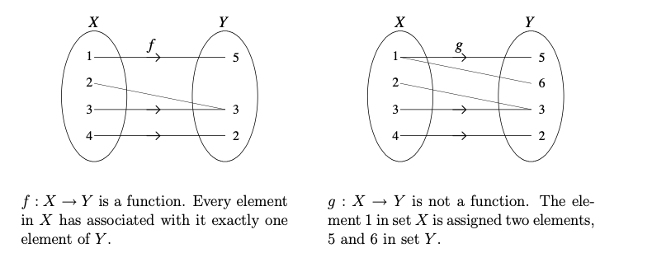

Slide 4

What is a function?
A function can also be described as a set of ordered pairs (x, y) such that for any x-value in the set, there is only one y-value. This means that there cannot be any repeated x-values with different y-values.
The examples above can be described by the following sets of ordered pairs.

Slide 5
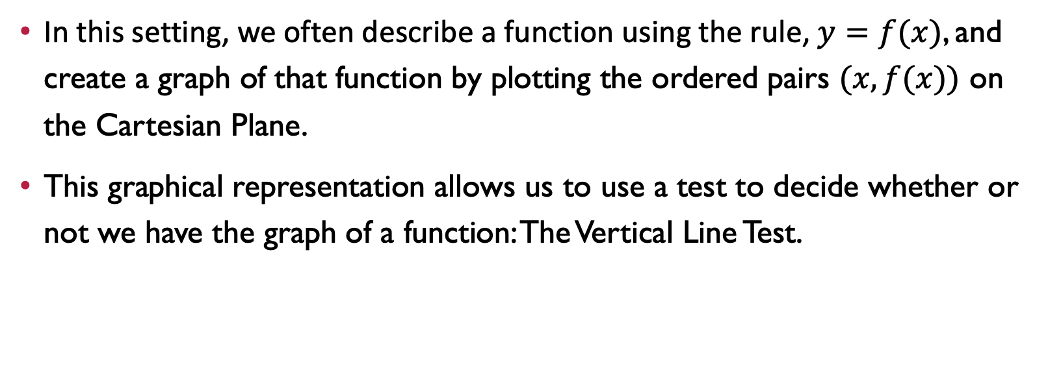
What is a function?
In this setting, we often describe a function using the rule, $y=f(x)$, and create a graph of that function by plotting the ordered pairs $(x,f(x))$ on the Cartesian Plane.
This graphical representation allows us to use a test to decide whether or not we have the graph of a function: The Vertical Line Test.

Slide 6
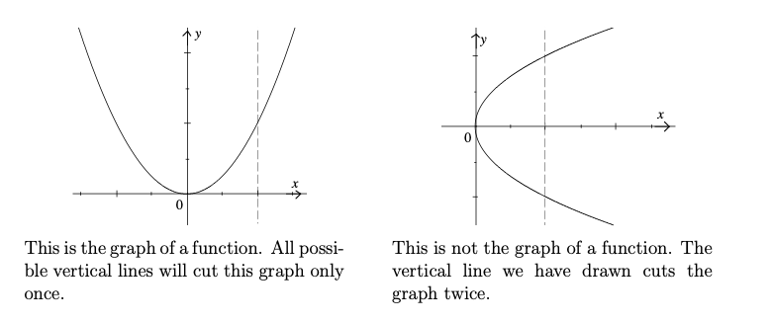
Vertical line test
The Vertical Line Test states that if it is not possible to draw a vertical line through a graph so that it cuts the graph in more than one point, then the graph is a function.

Slide 7
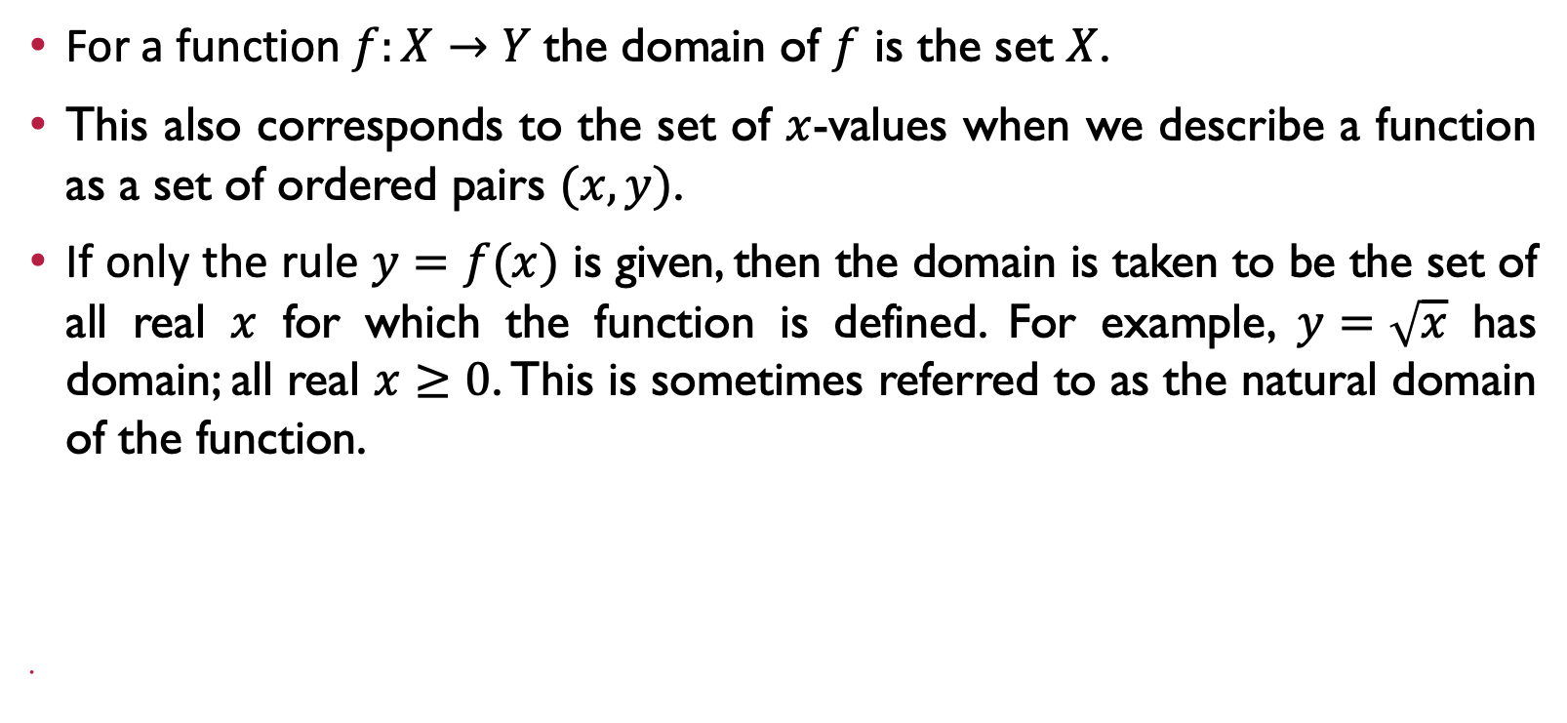
Domain of a function
For a function $f:X→Y$ the domain of $f$ is the set $X$.
This also corresponds to the set of $x$-values when we describe a function as a set of ordered pairs $(x, y)$.
If only the rule $y=f(x)$ is given, then the domain is taken to be the set of all real $x$ for which the function is defined. For example, $y=\sqrt{x}$ has domain; all real $x≥0$. This is sometimes referred to as the natural domain of the function.

Slide 8
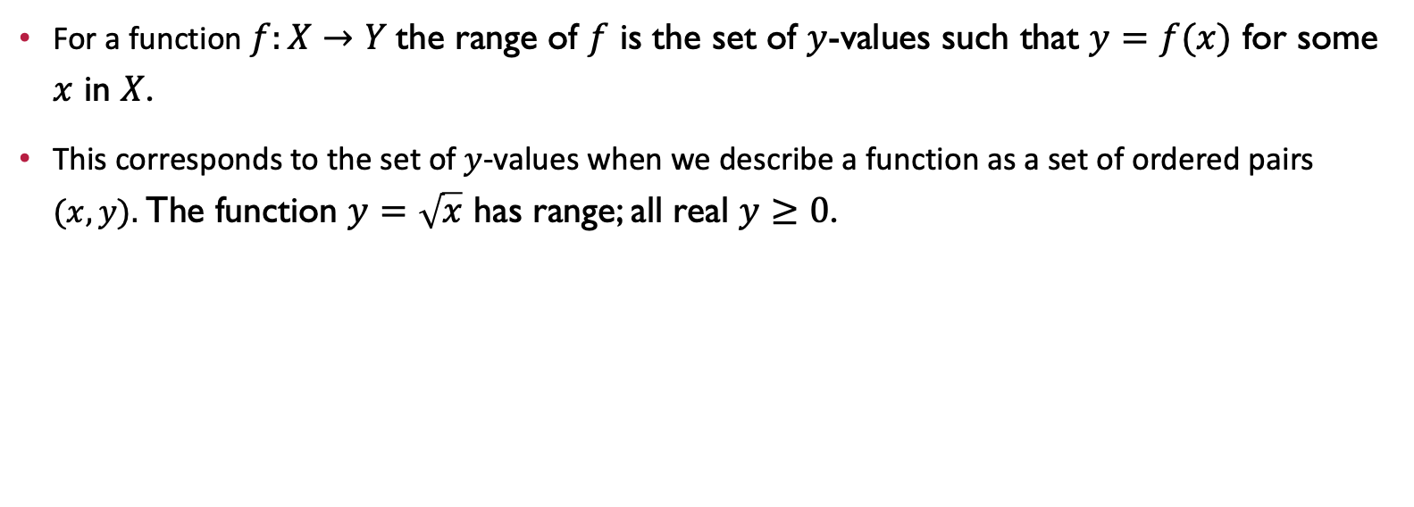
Range of a function
For a function $f:X→Y$ the range of $f$ is the set of $y$-values such that $y=f(x)$ for some $x$ in $X$.
This corresponds to the set of $y$-values when we describe a function as a set of ordered pairs $(x, y).$The function $y=\sqrt{x}$ has range; all real $y≥0$.

Slide 9
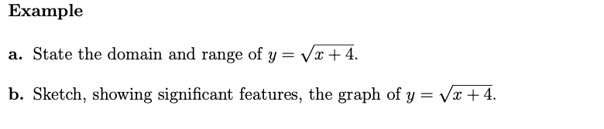
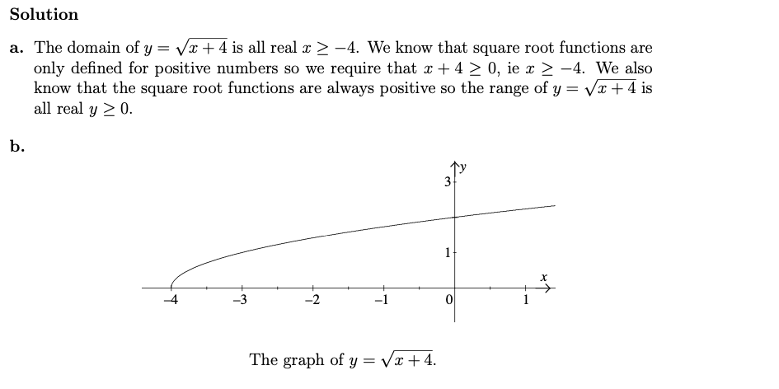
Examples

Slide 10
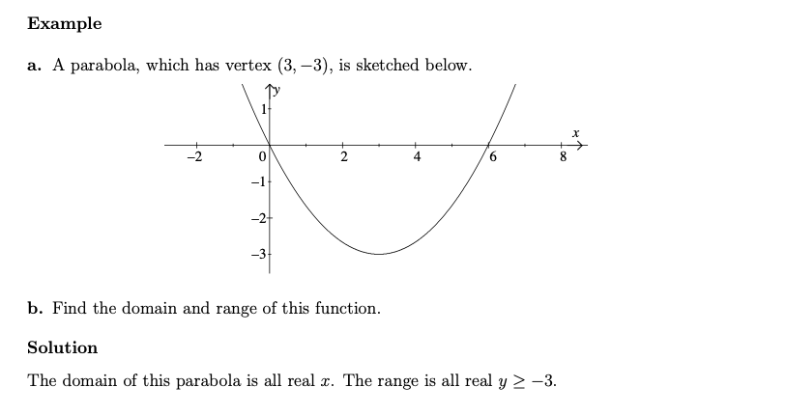
Examples

Slide 11
Thank You !

